Slide 1
Principal’s Report
GO Team Meeting #1

Slide 2
TOPICS
School Start Update
Current Enrollment & Leveling
School Strategic Plan
Strategic Plan Overview
SMART Goals
GMAS Results

Slide 3
School start
UPDATE

Slide 4
General Information about Start of School
Notes:
Principals – please provide a general update as to how the school year is going

Slide 5
Enrollment
Projected Enrollment | 437
Current Enrollment | 438
Difference | 1
Leveling
Leveling is the process the District uses to adjust school budget allocations to match student enrollment.
Budget Impact | $ 84,000 (This is about $4500 for the one student and $79,00 from reserves)
Notes:
Principals: Based on your enrollment, please give your GO Team the information on how you plan to account for any budget changes due to leveling.

Slide 6
2021-2025
Strategic Plan

Slide 7
A caring school embracing community, respect, honesty and hard work.
F. A. Toomer
Strategic Plan
2021-2025
At Toomer, we cultivate global citizens and life-long learners through inquiry, voice, choice, and agency. We provide a safe and equitable community that embraces diversity to inspire students to become critical agents of change.
SMART Goals
Reading
Increase the % of grades 3-5 students scoring proficient or above in reading from 25% to 35% by 2025
Math
Increase the % of grades 3-5 students scoring proficient or above in math from 25% to 35% by 2025
Behavior
The number of out of school suspensions will decrease from 29 days to 15 days by 2025
APS Strategic Priorities & Initiatives
School Strategic Priorities
School Strategies
Fostering Academic Excellence for All
Data
Curriculum & Instruction
Signature Program
1. Intentionally focus on closing the sub groups achievement gaps.
2. Implement research-based teaching strategies supported by student data.
3. Create a system of supporting problem solving and action with students and staff through the lens of IB.
4. Create and implement a system that promotes equitable practices in all areas of the school community.
-Weekly IB Unit Planning & Reflection
-Mid-Year intervention Plans & data review
-Equity Team/Monthly Meetings
-Intentional 360 instruction around individual learning gaps
-Develop conceptual learning & implementing research based mathematical teaching & learning practices
Building a Culture of Student Support
Whole Child & Intervention
Personalized Learning
5. Foster a system of restorative practices that include students, staff, and families and all wrap around services.
6. Implement a robust wrap around program with clear goals, communication plan, and measurement structure.
-Safety patrol/Restorative student leaders
-Restorative practice committee/Coach next year
-Develop student clubs with clear objectives
-IB Training
-Create pipeline for aspiring leaders through flexible master teacher teams
-Differentiated professional learning & vertical monthly Teaming
-Clearly flesh out new teacher mentor program (Teacher rounds)
Equipping & Empowering Leaders & Staff
Strategic Staff Support
Equitable Resource Allocation
7. Create and support a development path for all staff that includes school based leadership.
8. Foster a “whole adult” system of support.
9. Foster the culture of individualized support for all staff members.
Creating a System of School Support
Collective Action, Engagement & Empowerment
10. Develop and implement a parent engagement plan, based on mutual communication and impact data.
11. Create a mentorship programs for students and staff, students and students, students and parents.
12. Foster a culture of staff, student, parent, and community voice.
-Monthly community engagement
Community coffees
-Student-Led restorative practice group
Quarterly student learning showcase

Slide 8
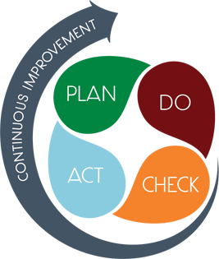
Strategic Plan Smart Goals
Overview
Priorities
Key Aspects
SMART GOALS

Slide 9
Georgia Milestones Assessment Results

Slide 10
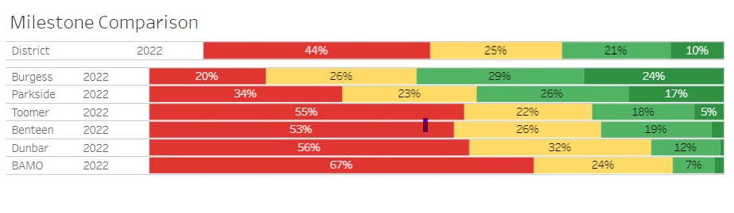
2021-2022 ELA GMAS
Notes:
Dunbar is doing better in general
Similar to benteen
Looking at all the Jackson schools not too far behind with developing
Developing at the same levels across the district and other schools

Slide 11
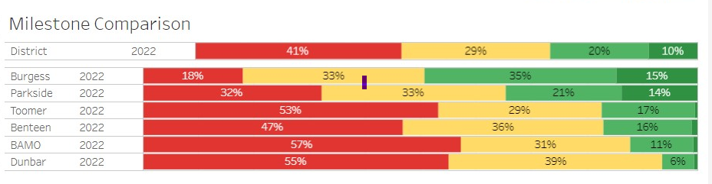
2021-2022 Math GMAS
Notes:
Less students meet distinguished
more students are developing in math
Far below the district averages
Wanting to do observations

Slide 12
Questions?

